Slide 1
ASP.NET Security

Slide 2
Security
Contoso University
Data Migrations
Users en Roles
Authentication
Authorization
Areas

Slide 3
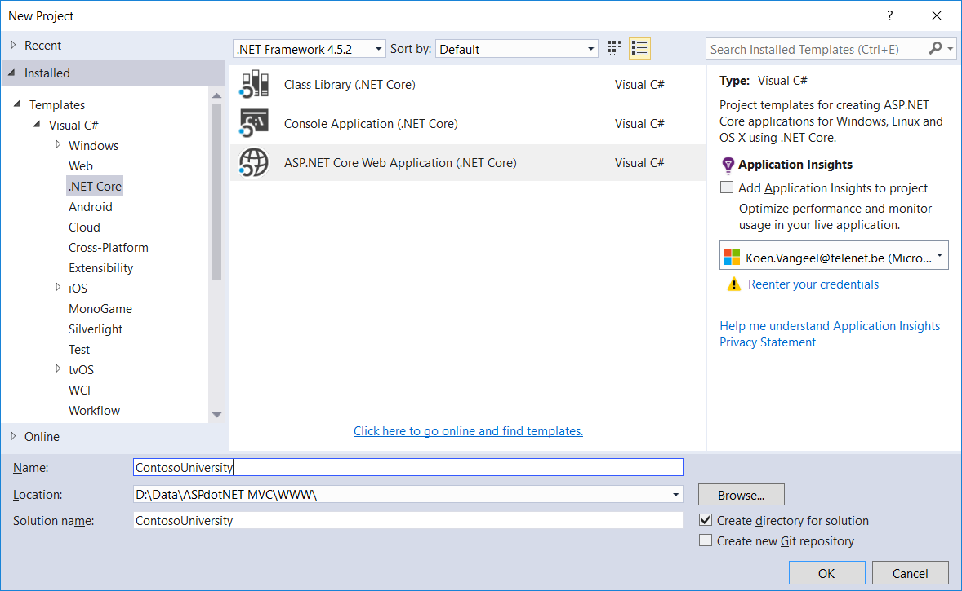
Getting started
File | New Project
ContosoUniversity
Bewaar in www
Create new Git repository
(mag je uit zetten)

Slide 4
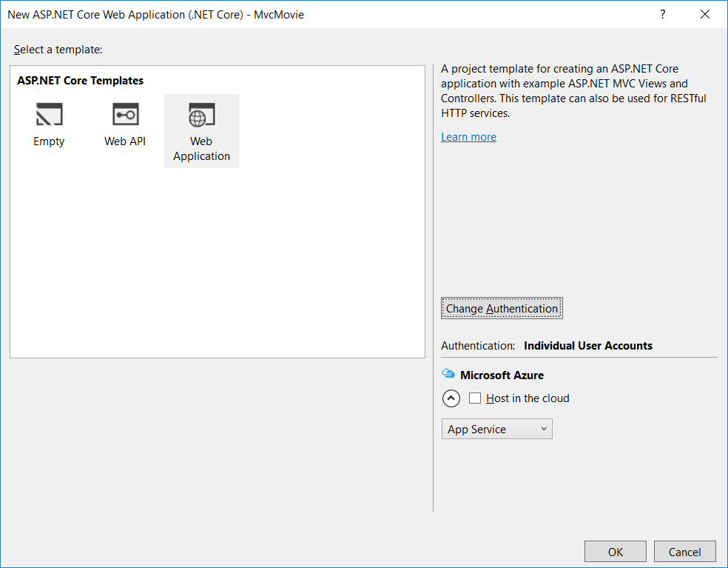
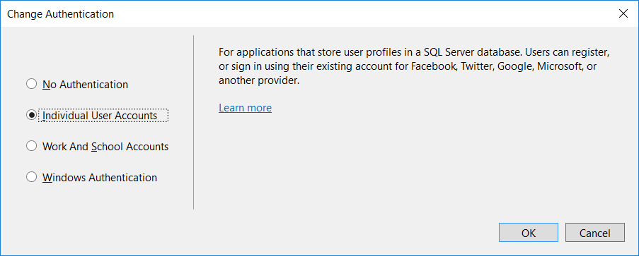
Getting Started

Slide 5
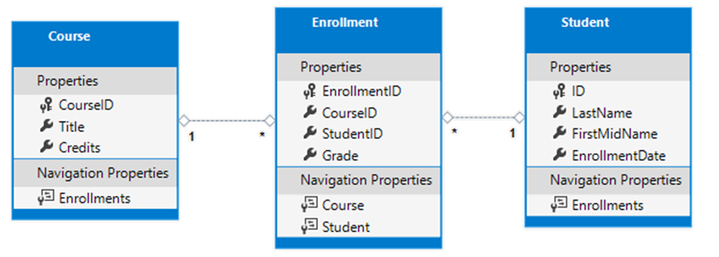
Data Model

Slide 6
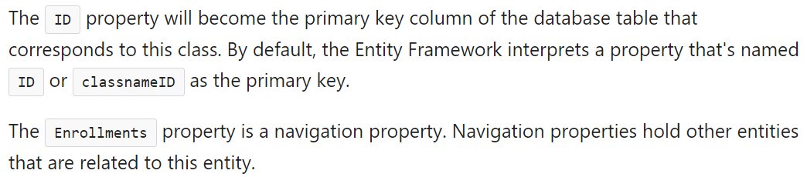
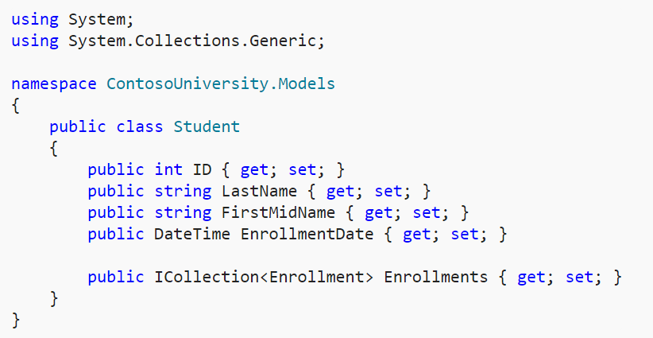
Creating the models (uit resources)
Models
Student.cs

Slide 7
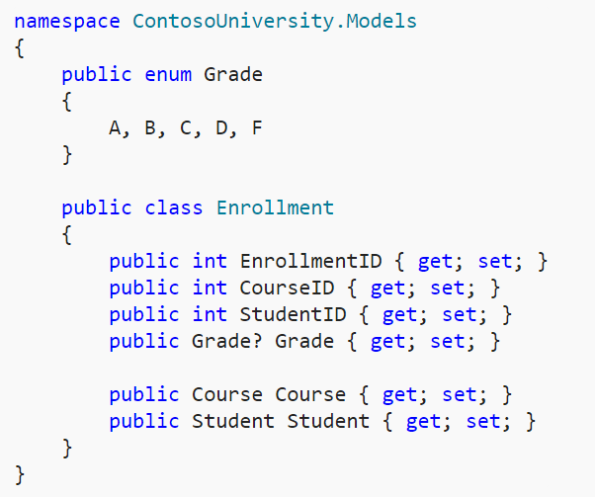
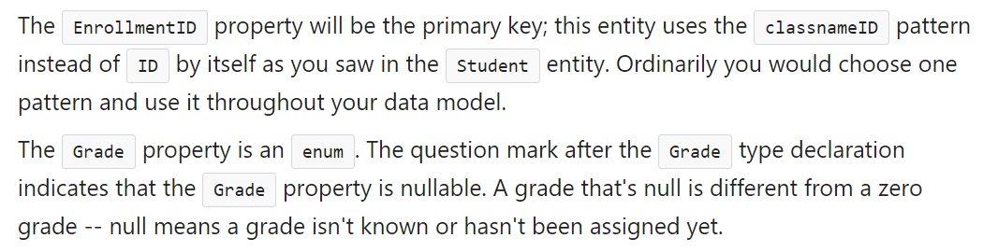
Enrollment.cs

Slide 8
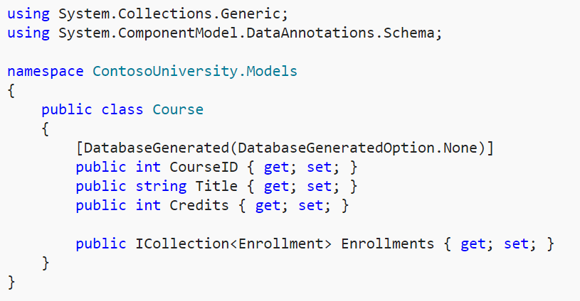
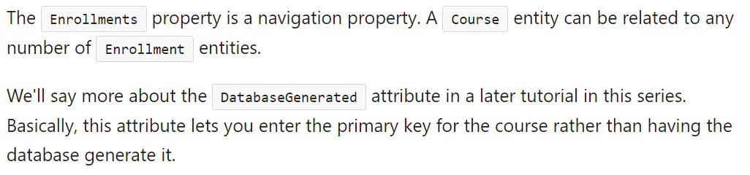
Course.cs

Slide 9
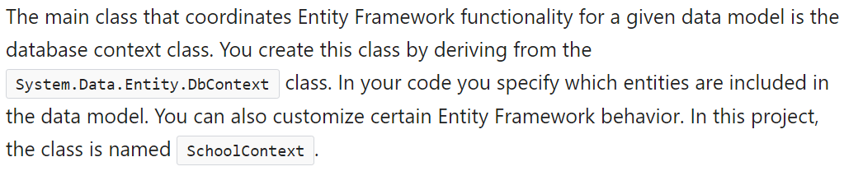
Database Context (uit resources)
Data
SchoolContext.cs

Slide 10
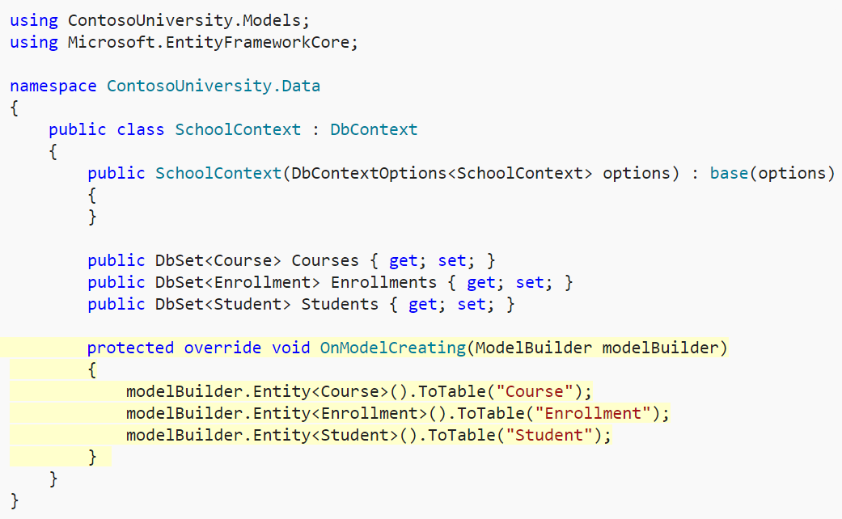
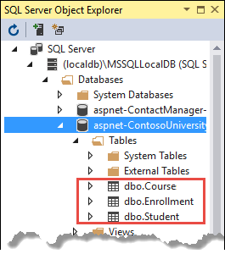
SchoolContext.cs

Slide 11
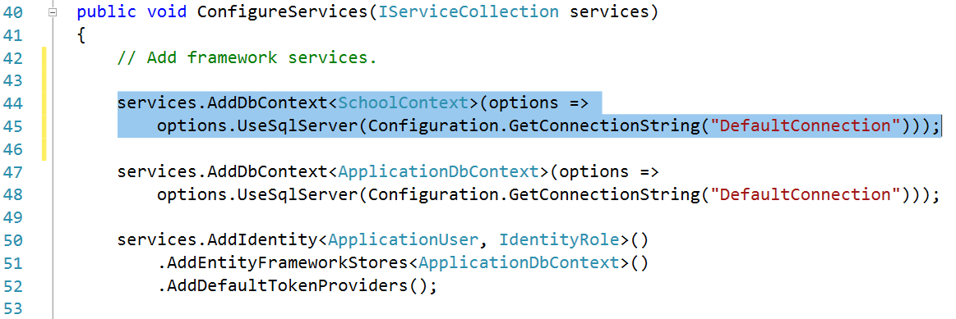
Startup.cs
Registeer SchoolContext as a service

Slide 12
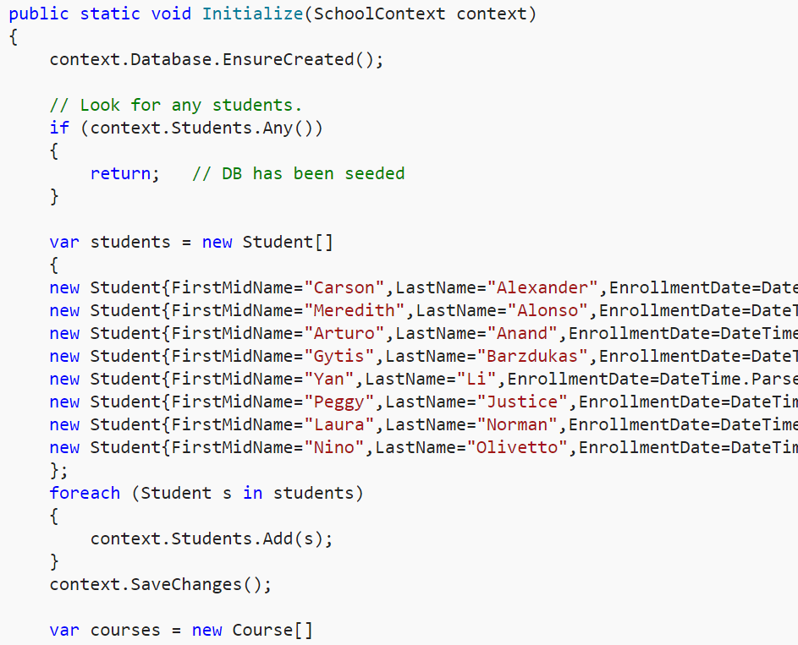
Test Data (uit resources)
Data
DbInitializer.cs

Slide 13
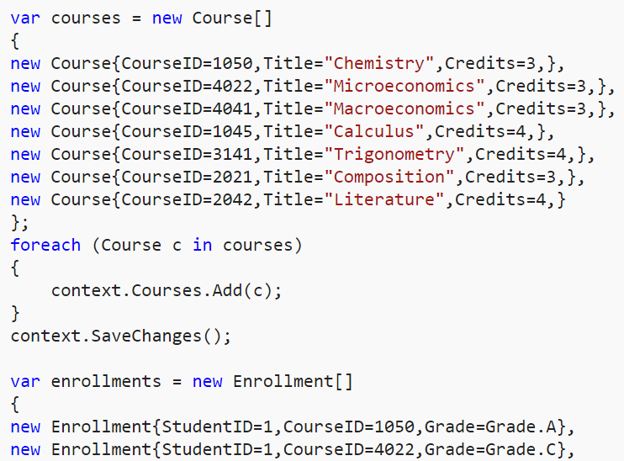
Test Data

Slide 14
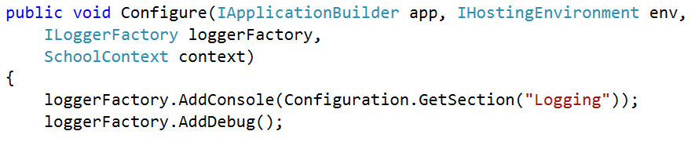
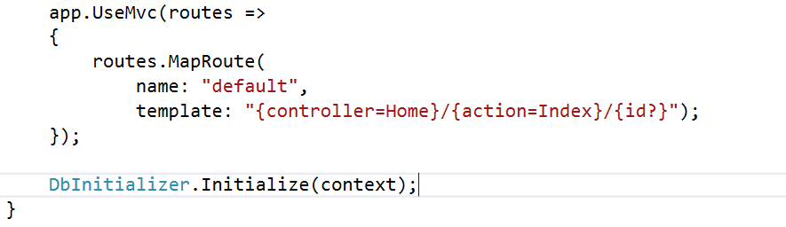
Startup.cs

Slide 15
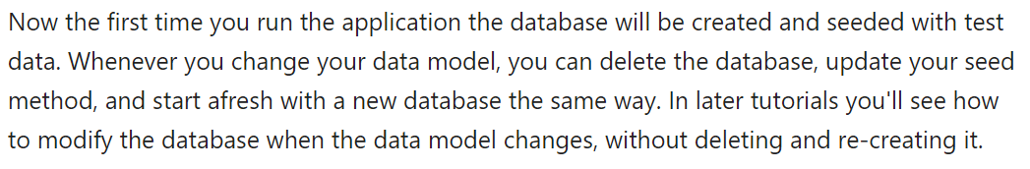
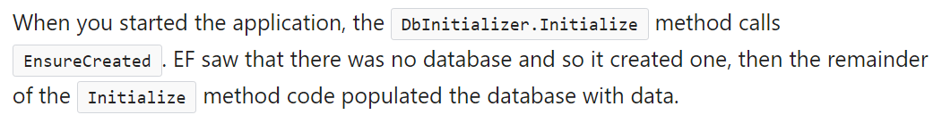
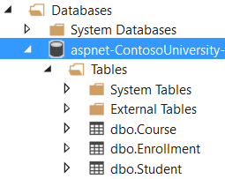
Run The Application (CTRL-F5)

Slide 16
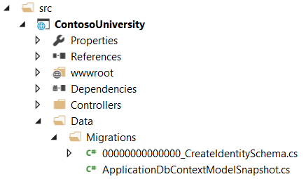
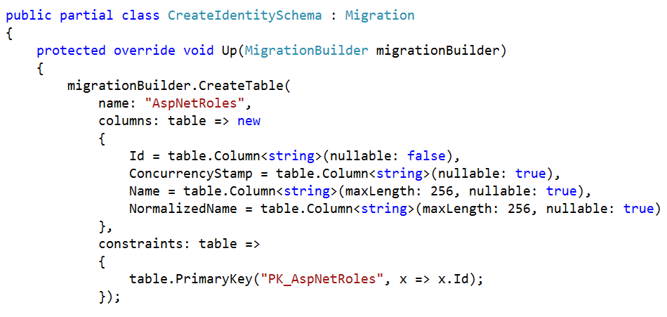
Extra Security Tables
Via Data Migrations
Open CreateIdentitySchema.cs
Door bij de creatie v/h project te kiezen voor Inidividual User Accounts werd dit migratiescript al klaar gezet

Slide 17
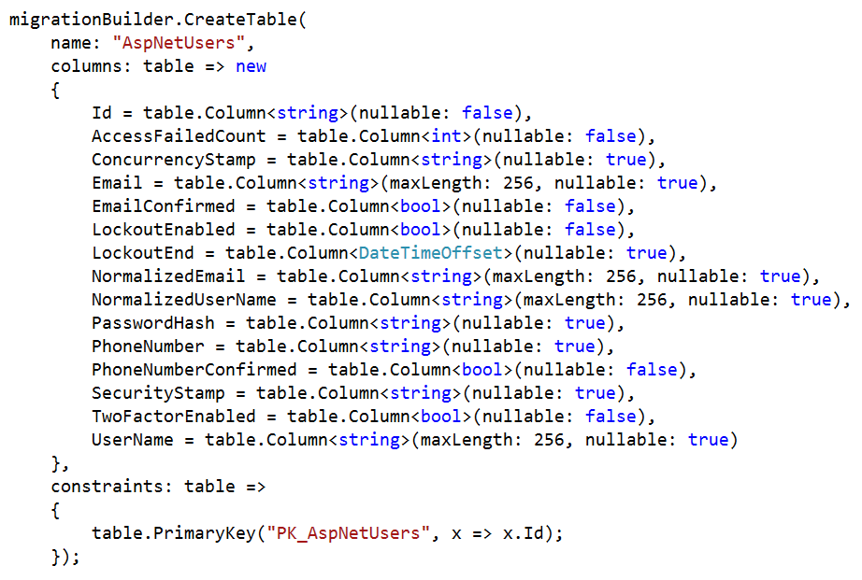
Security Tables

Slide 18
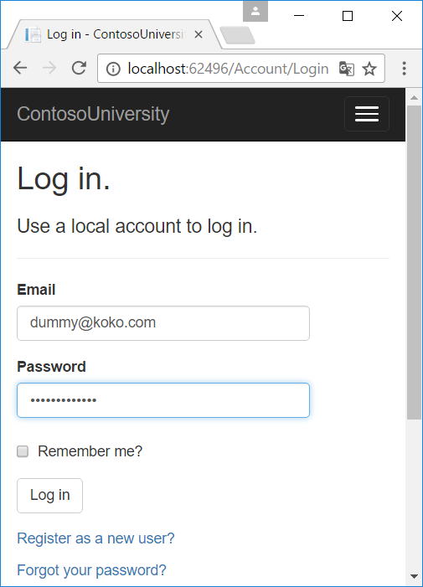
Migratiescript toepassen
Ofwel
via de command prompt
door het Contoso University project zelf
Login

Slide 19
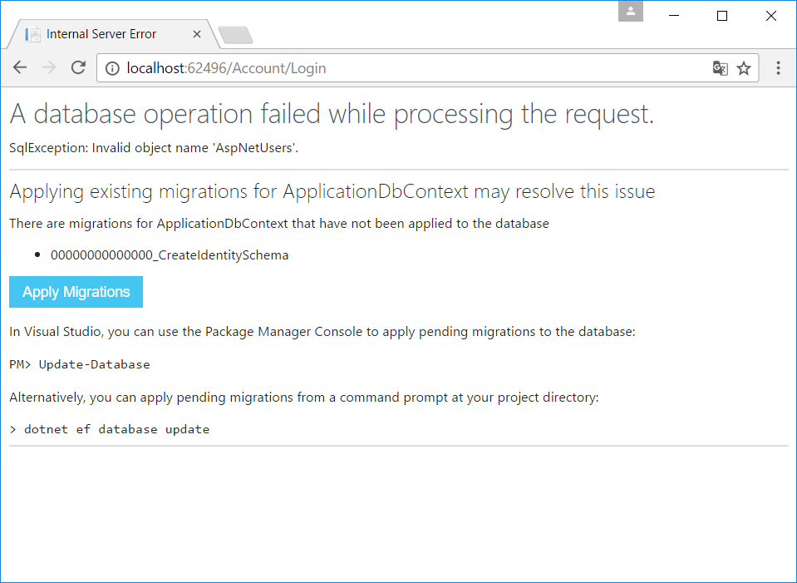
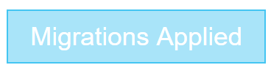
Apply Migrations

Slide 20
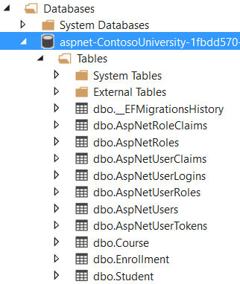
Contoso Database

Slide 21
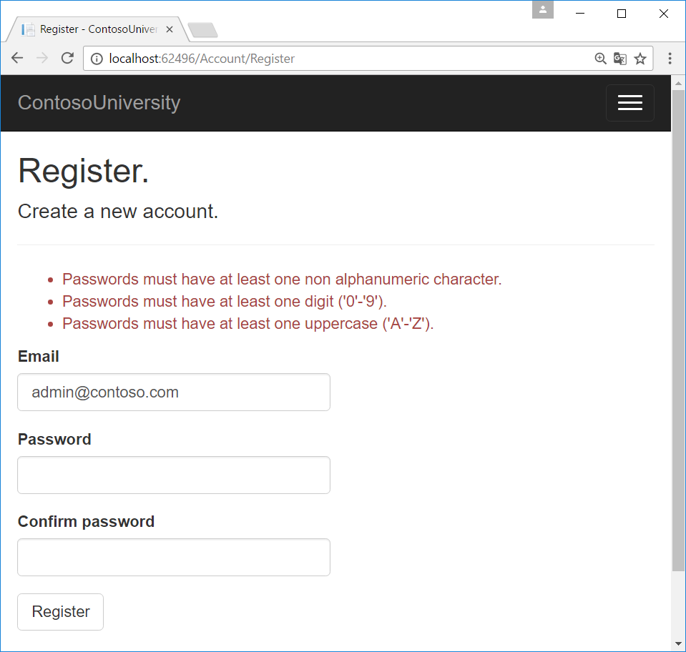
Authentication
Register

Slide 22
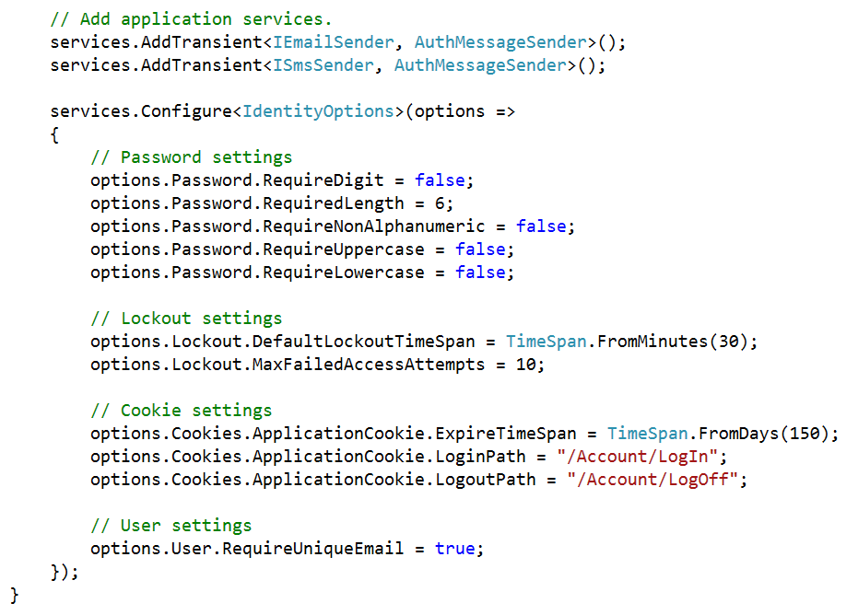
Password requirements (startup.cs.txt uit resources)

Slide 23
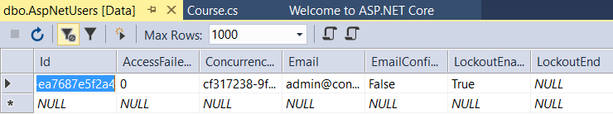
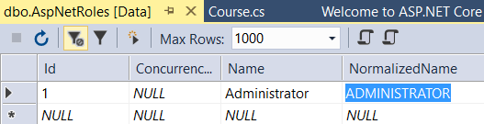
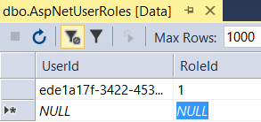
Administrator
Register
admin@contoso.com
contoso 2x

Slide 24
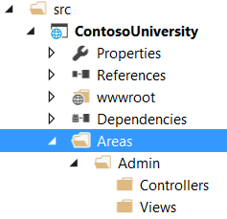
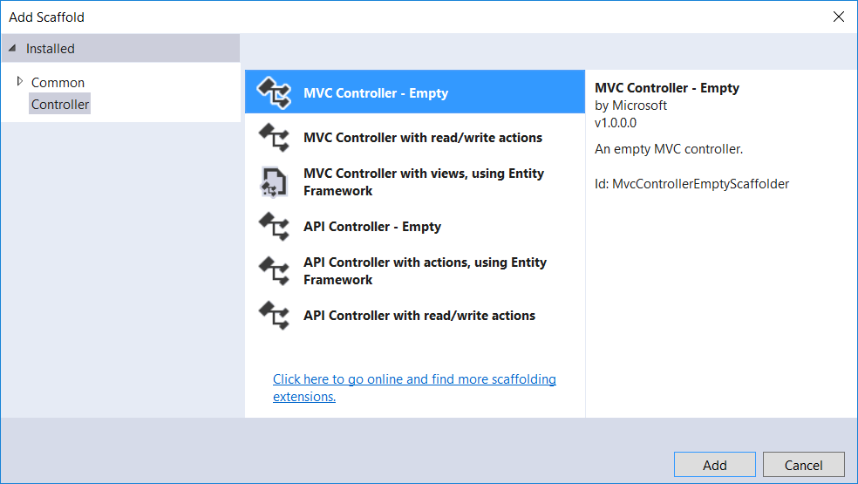
Een aparte admin Area
ContosoUniversity | Add Folder | Areas
Areas | Add Folder | Admin
Controllers
Views
Controllers | Add Controller
MaintainController.cs

Slide 25
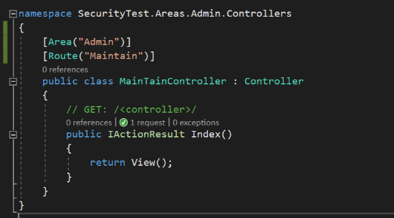
Maintaincontroller.cs

Slide 26
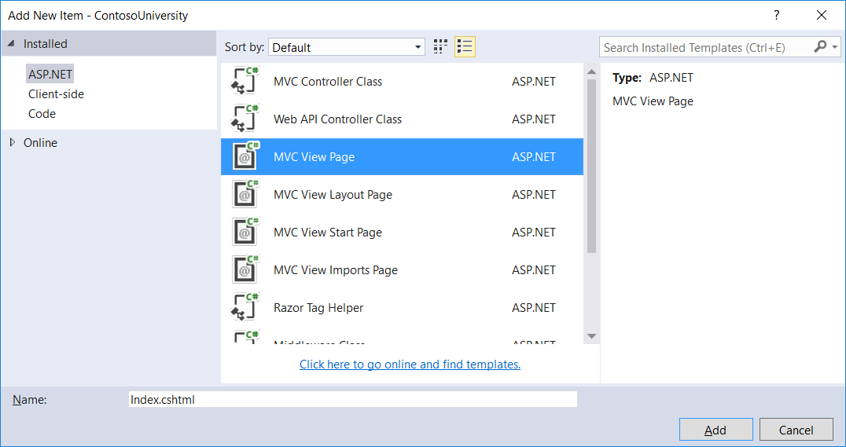
Admin Index View
Views | Add New Folder | Maintain
Maintain | Add New Item
MVC View Page
Index.cshtml

Slide 27
Index.cshtml
@{
ViewData["Title"] = "Maintain Page";
}
<h2>@ViewData["Title"]</h2>
<h4>Admin panel</h4>

Slide 28
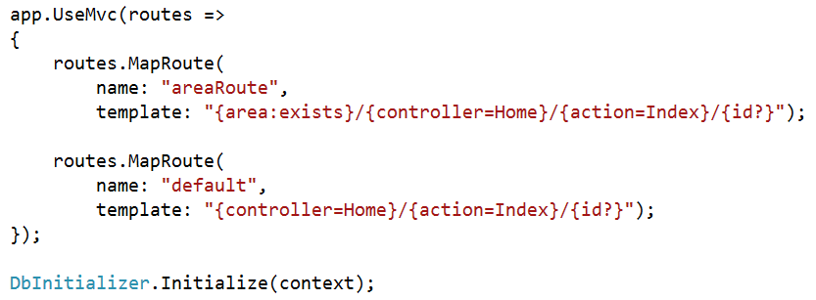
Startup.cs (uit startup.cs.txt resources)
https://docs.microsoft.com/en-us/aspnet/core/mvc/controllers/areas

Slide 29
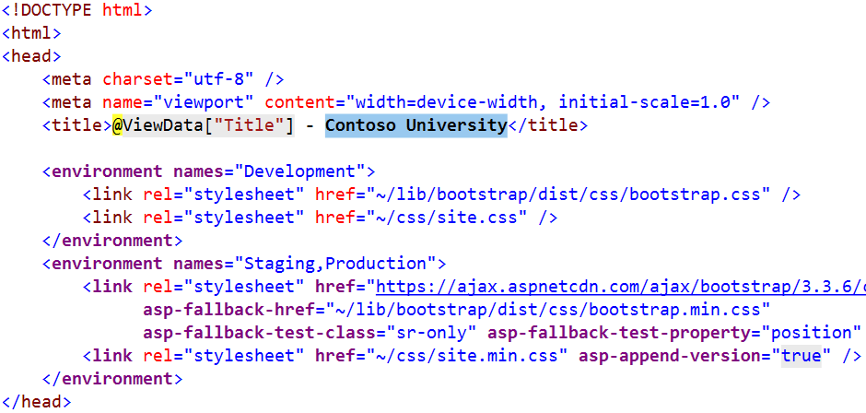
_Layout.cshtml (3x aanpassen Contoso University)

Slide 30
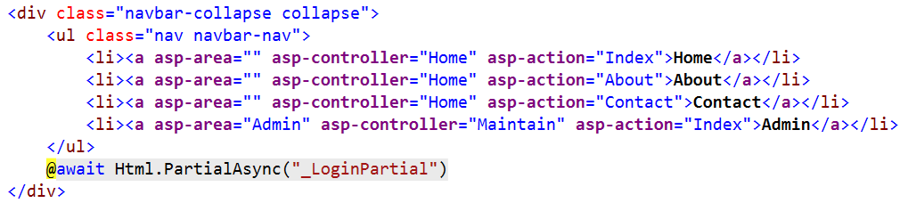
_Layout.cshtml

Slide 31
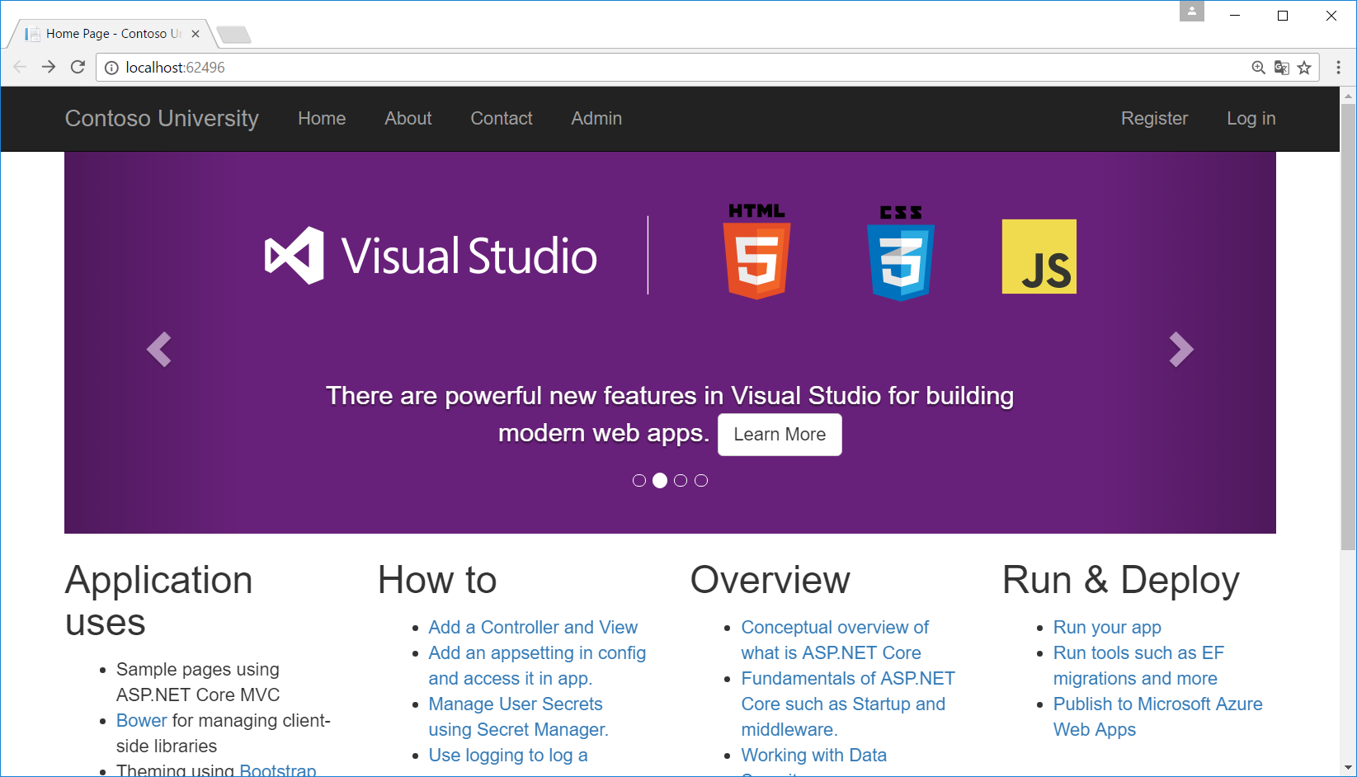
Admin menu

Slide 32
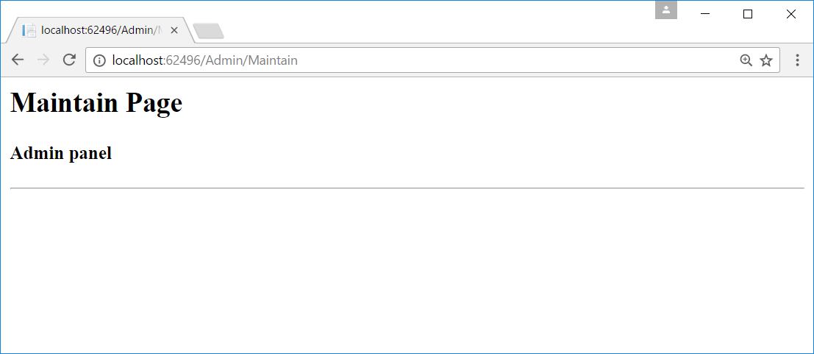
Maintain page

Slide 33
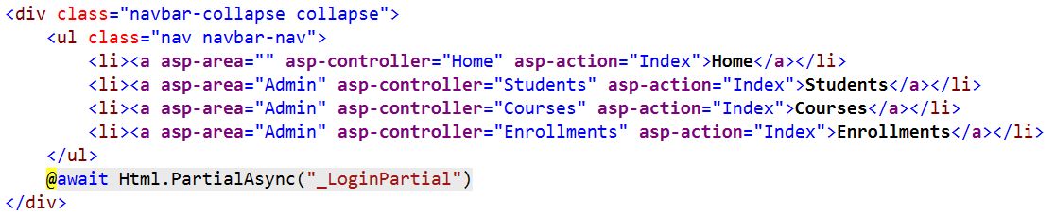
Andere layout/menu voor Admin Pages
_Layout.cshtml | Copy
Paste | _LayoutAdmin.cshtml

Slide 34

Default Layout voor Admin pages
Areas/Admin/Views
_ViewStart.cshtml (kopiëren uit resources)

Slide 35
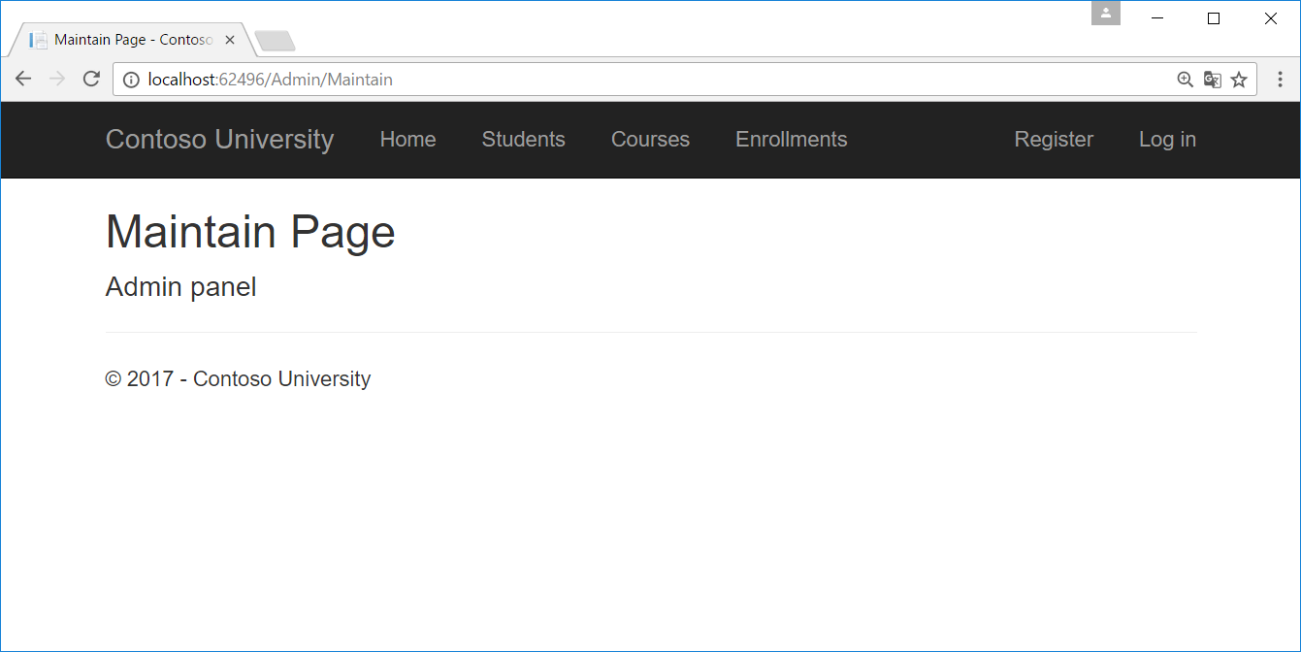
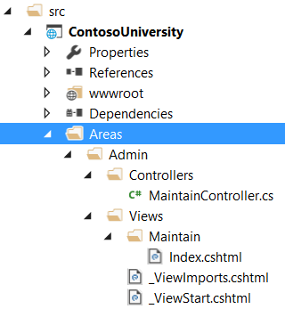
Alleen Admin toegang geven tot Admin Area

Slide 36
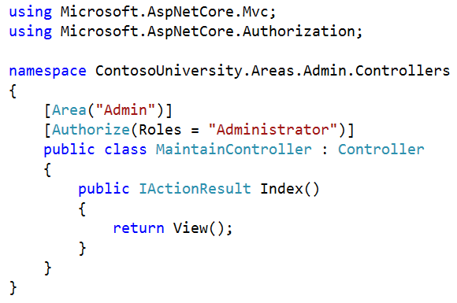
Authorization

Slide 37
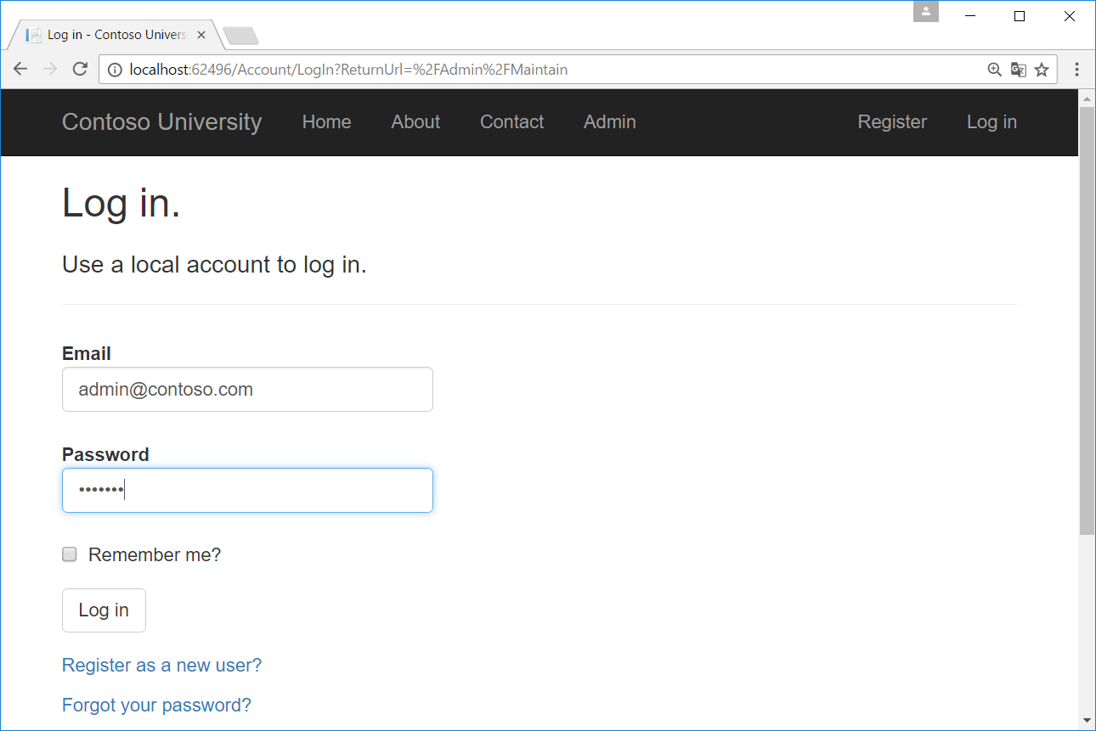
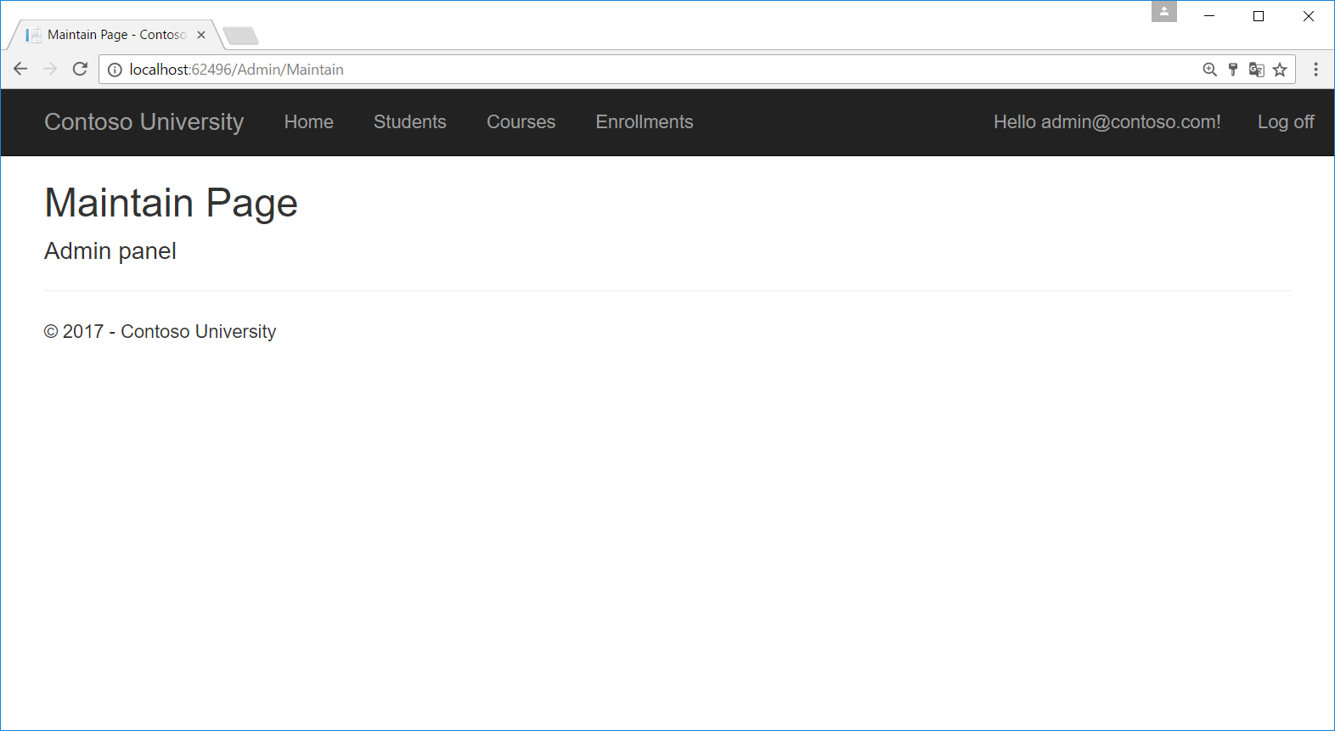
Authorization

Slide 38
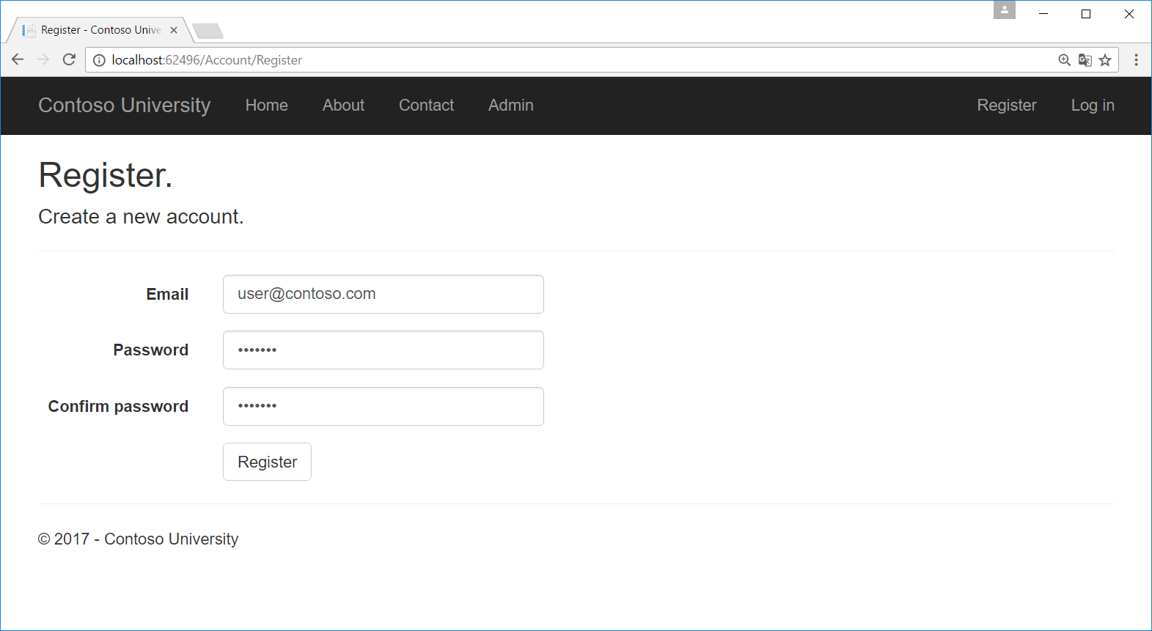
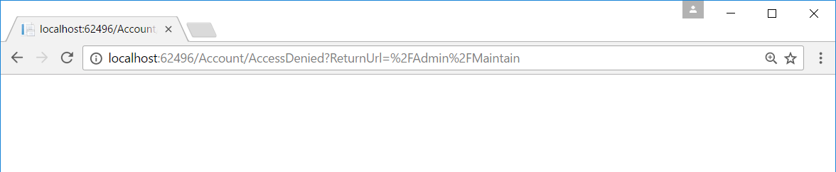
User Zonder Administrator Role
Logoff
Register
user@contoso.com

Slide 39
https://docs.microsoft.com/nl-nl/aspnet/core/security/authentication/social/index

